Slide 1
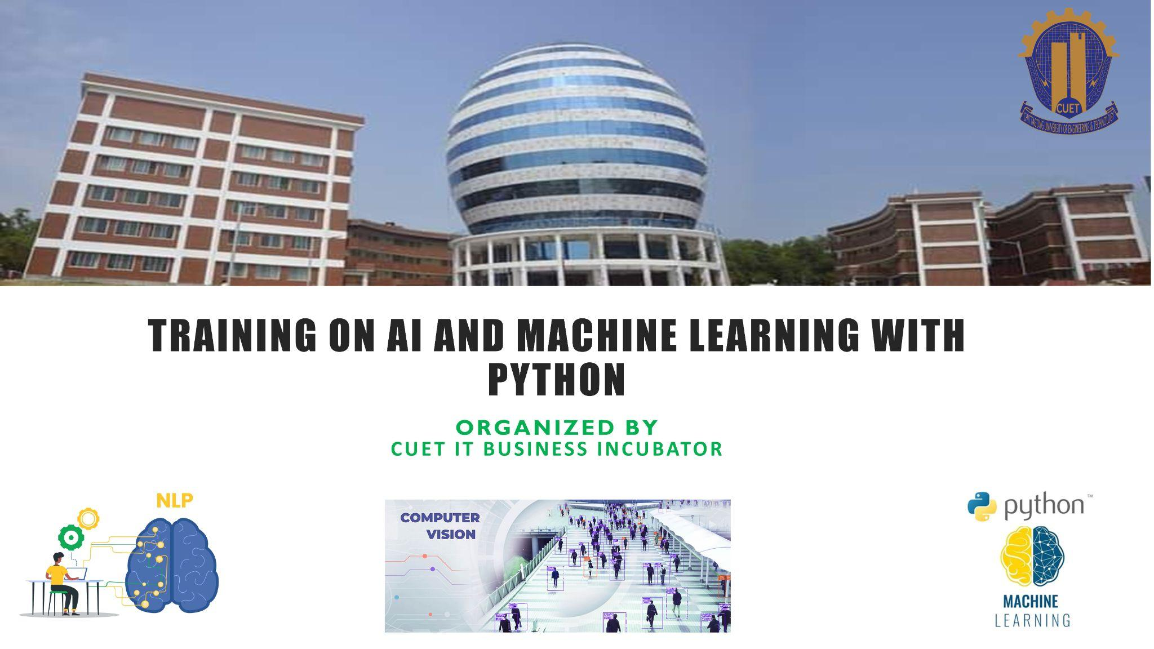

Slide 2
Support Vector Machine

Slide 3

The goal of the SVM algorithm is to create the best line or decision boundary that can segregate n-dimensional space into classes.
We can easily put the new data point in the correct category in the future. This best decision boundary is called a hyperplane.

Slide 4
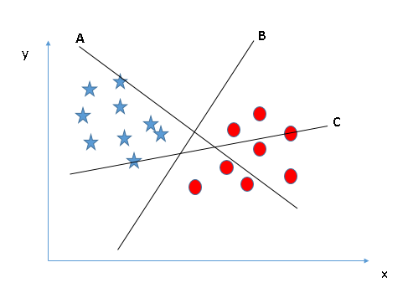
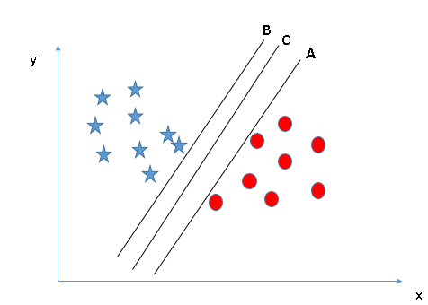
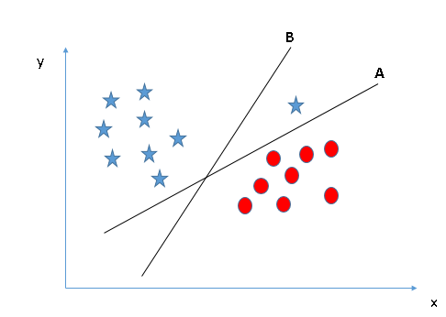
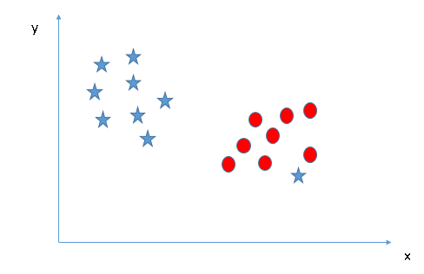

Slide 5
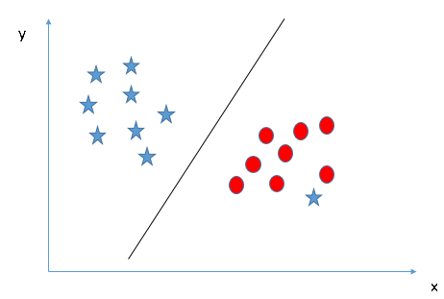
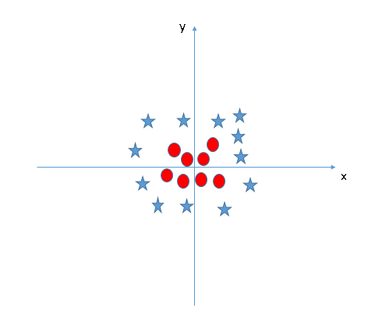
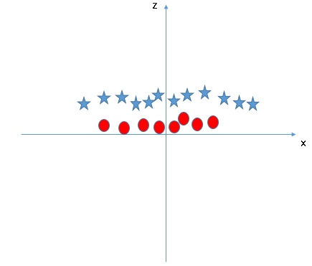
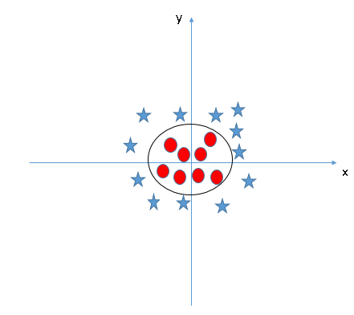

Slide 7
Kernel Trick

Slide 8
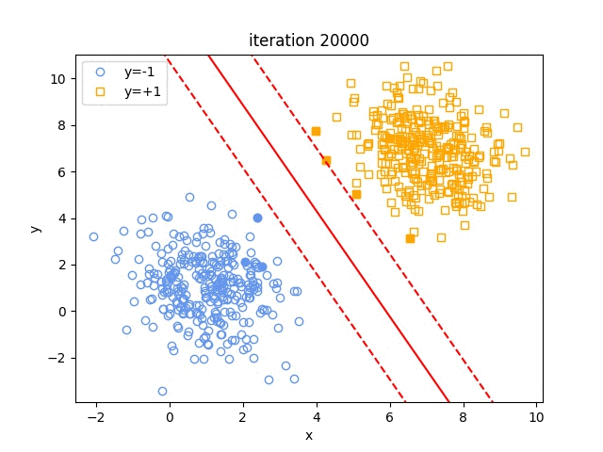
SVM Visualization

Slide 9
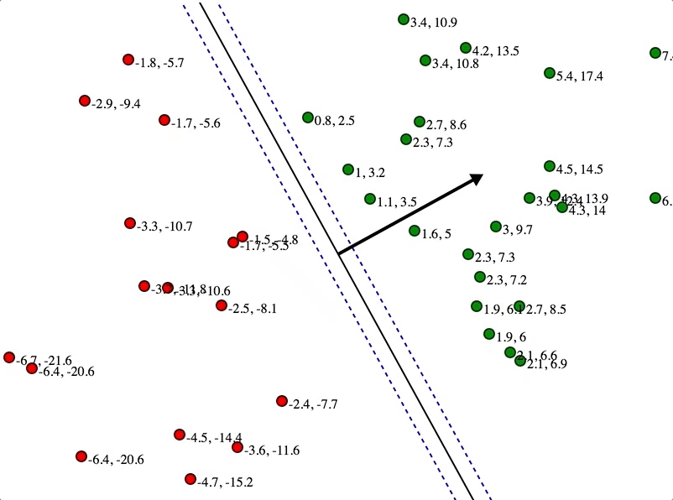
SVM Visualization

Slide 10
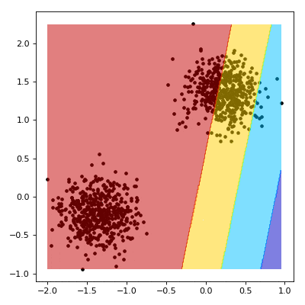
SVM Visualization

Slide 11
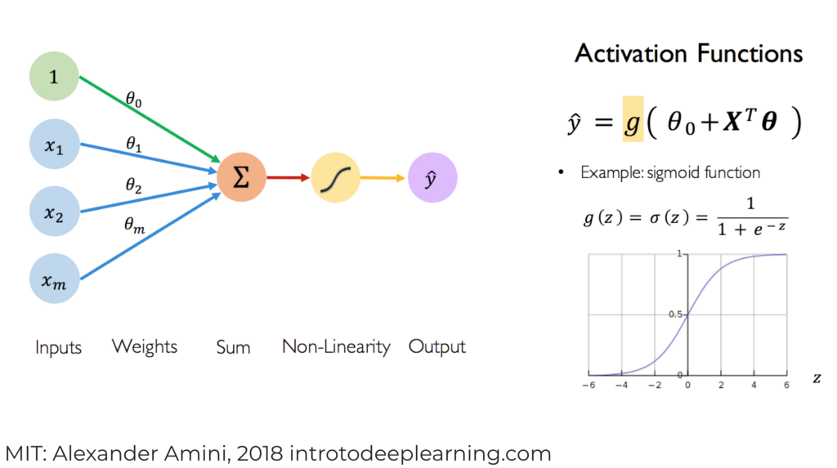
Neural Network

Slide 12
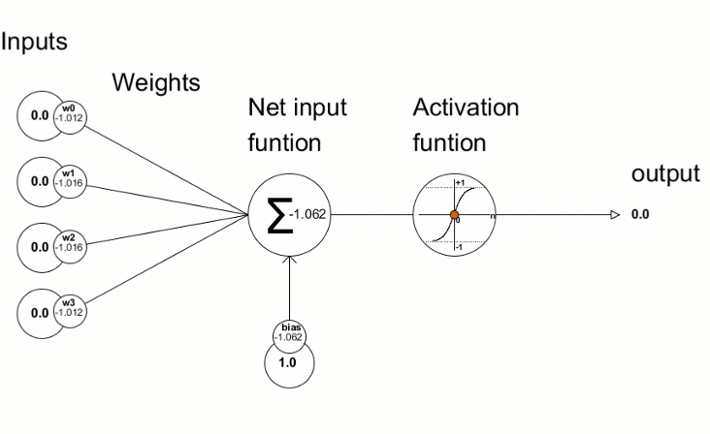

Slide 13
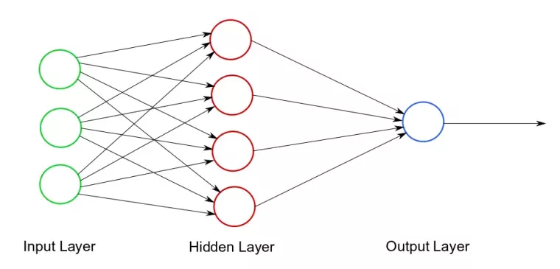
Neural Network

Slide 14

Neural Network

Slide 15
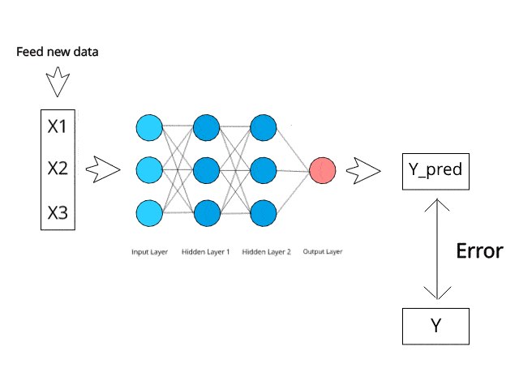
Neural Network

Slide 16
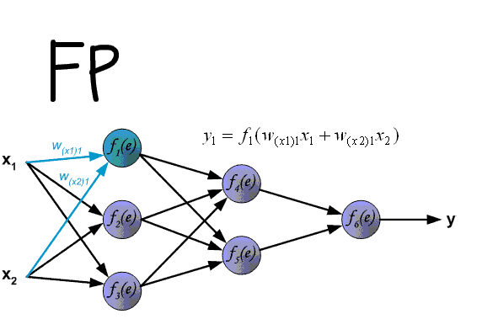
NN with Backpropagation

Slide 17
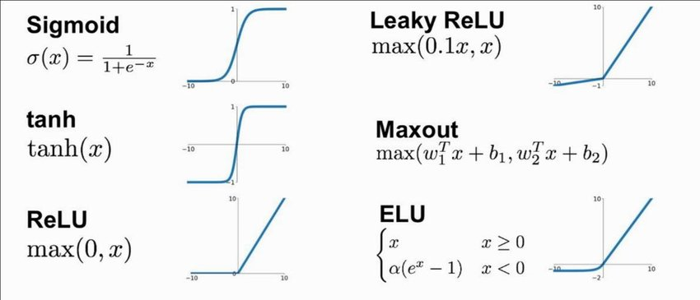
Activation Function

Slide 18
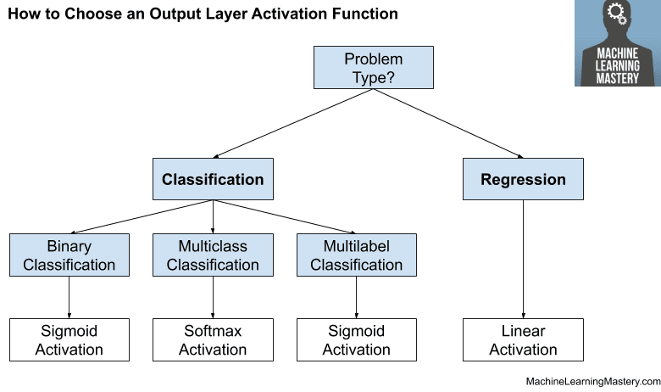
Activation Function

Slide 19
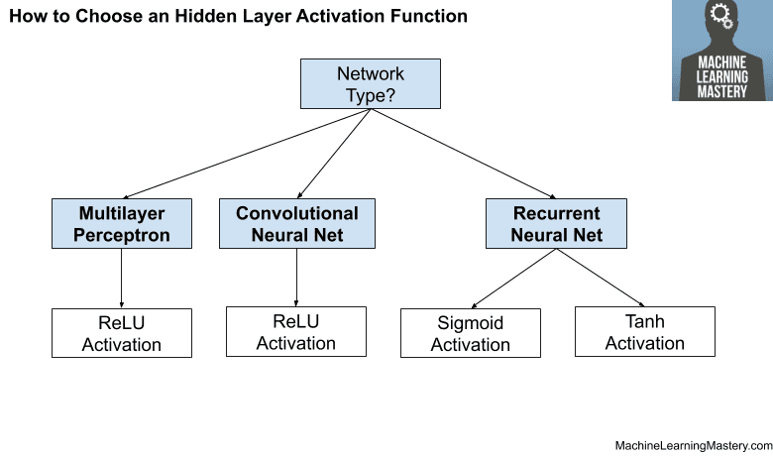
Activation Function

Slide 20
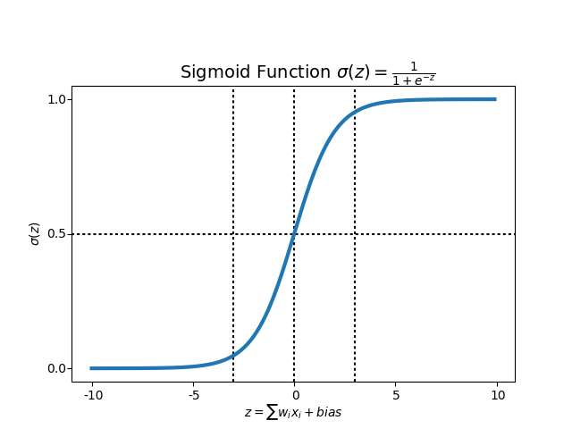
Sigmoid vs Softmax

Slide 21
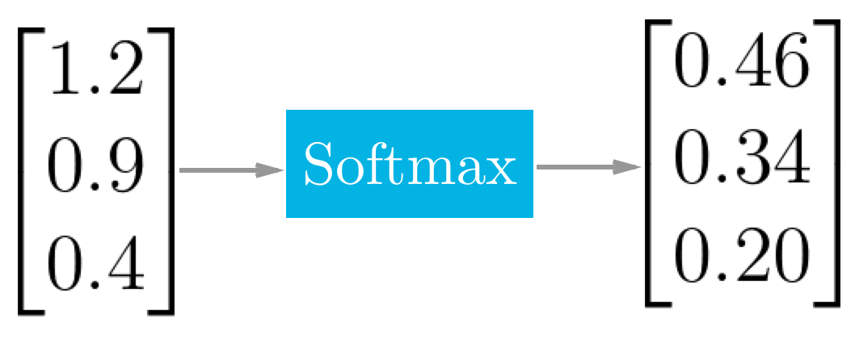
Sigmoid vs Softmax

Slide 22
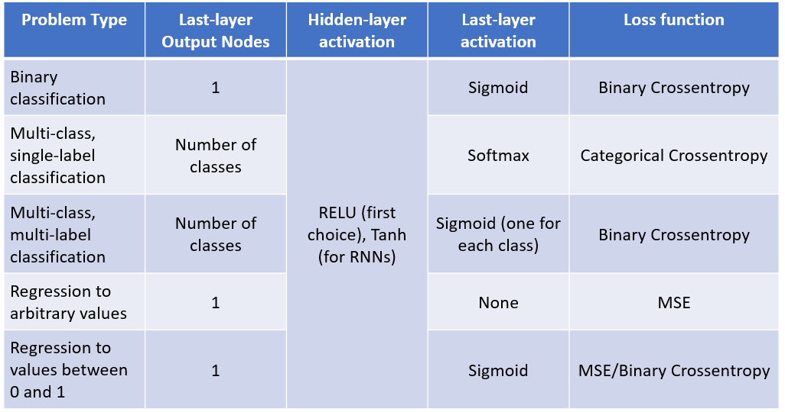
Loss Function

Slide 23
Loss Function

Slide 24

Optimizers

Slide 25
Optimizers

Slide 26
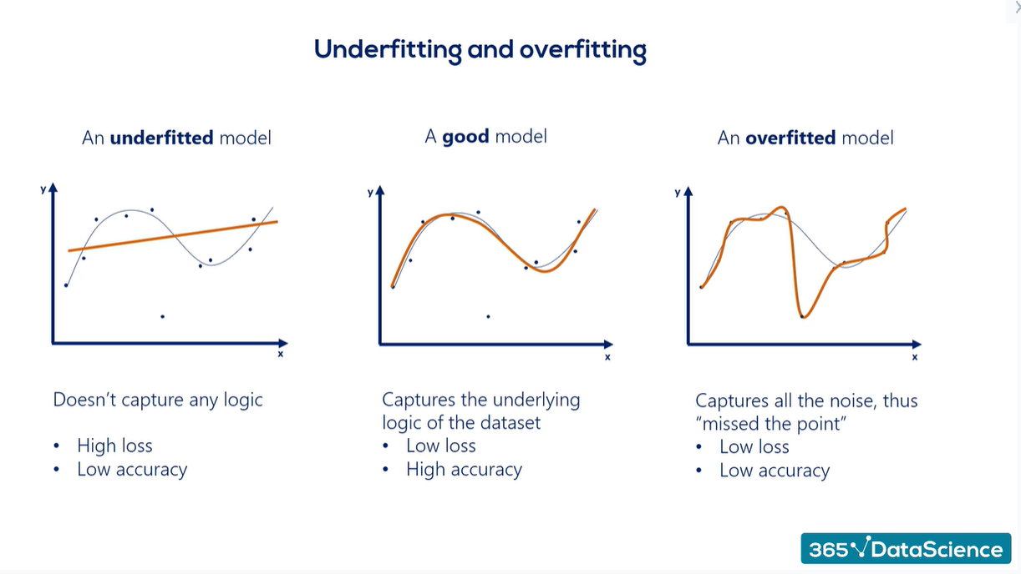
Overfitting & Underfitting

Slide 27
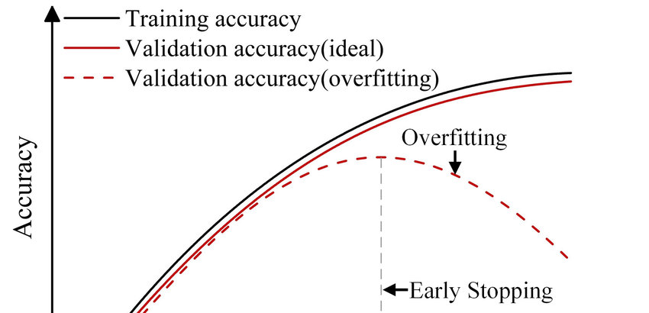
Overfitting & Underfitting

Slide 28
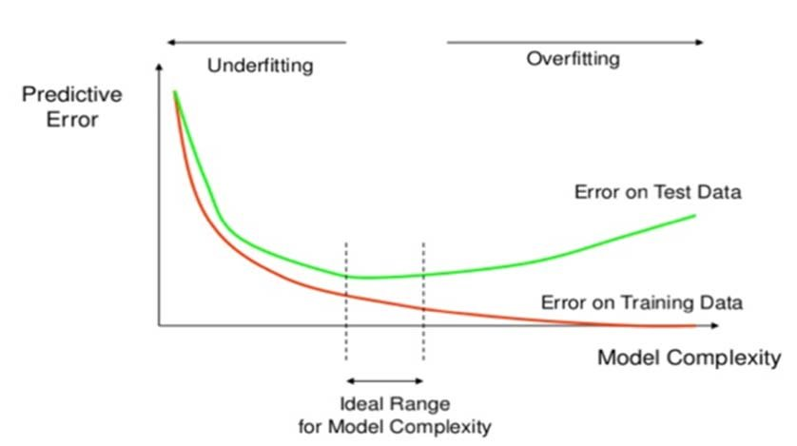
Overfitting & Underfitting

Slide 29
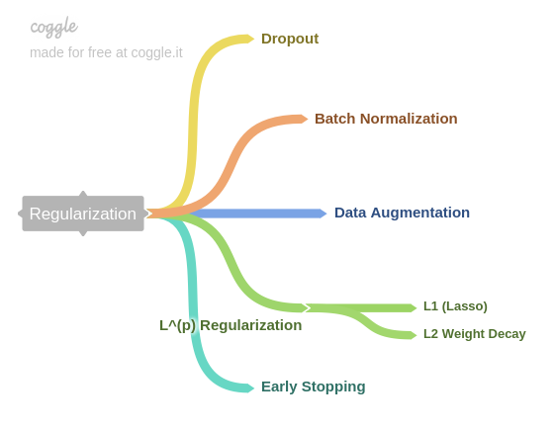
How to mitigate Overfitting

Slide 30
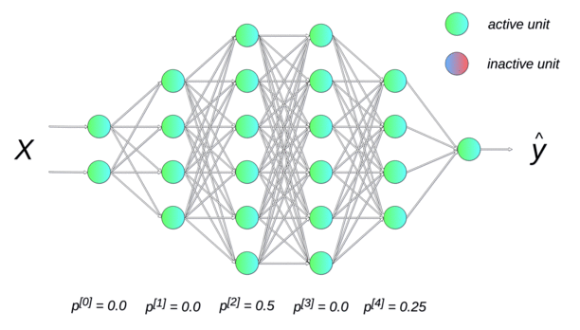
Dropout

Slide 31


